Slide 1


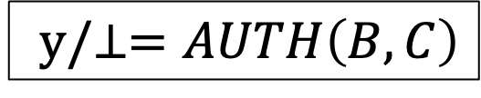
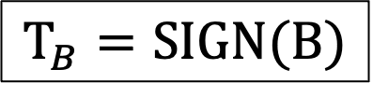
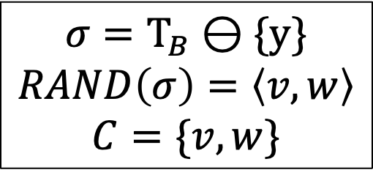
$$Τ_{B}=SIGN(B)$$
$$B$$
$$C$$
$$y/⊥=AUTH\left(B,C\right)$$
Search
$$σ=Τ_{B}⊖\{y\}$$
$$RAND\left(σ\right)=\left\langle v,w\right\rangle$$
$$C=\{v, w\}$$

